Slide 1


Data Informed Career Path Dashboard Visualizing U.S. Bureau of Labor Statistics Data for Occupational and Employment Decisions
Ahmed Alsalim, Alexander Brown, Ruijie Rao
Final Project for USC Viterbi DSCI-551 (Spring 2022)
Introduction | 1
Notes:
Alexander

Slide 2
Problem We Are Addressing
People are experiencing career disruptions caused by the COVID-19 pandemic.
People are having a hard time making career decisions or making wrong decisions.
Lack of transparent information about current labor market in the US.
Solution We Have
Collected and aggregated trustworthy data from U.S. Government Bureau of Labor Statistics.
Built a user-friendly Data Visualization Dashboard that displays:
Overview and detailed information including employment rate, salary status and educational requirements.
On almost every currently existing career.
We believe this application can help people to make Data Driven Decisions and help them make it through this pandemic.
Introduction | 2
Notes:
Alexander

Slide 3
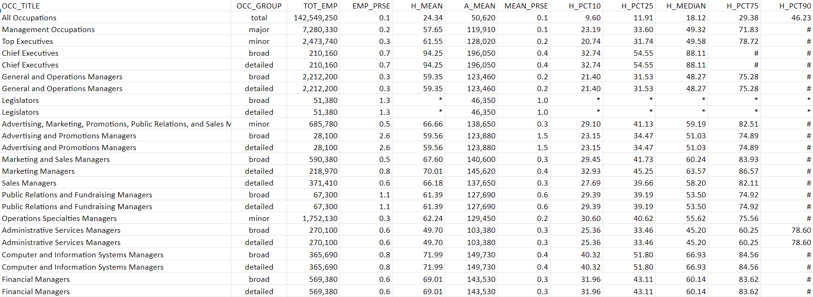
Data We Are Using
Data collected by U.S. Government Bureau of Labor Statistics. (www.bls.gov/oes)
Fields include: OCC Code, OCC Title, Total Employment, Annual & Hourly Mean Salary, Job per 1k and etc.
Data ranges from 1988 to 2021.
Data | 3
Notes:
Ahmed

Slide 4
Data Cleaning (Ahmed)
Data preparation
Joining time-series data for 2019-2020
Cleaning (Google Colab/Pandas/Excel)
Missing values
Remove duplicates
Make feature data is in the right format(data type)
Saved raw data into CSVs, cleaned with pandas, uploaded to Firebase
Remove unnecessary features
Data | 5
Notes:
Ahmed
Merging two datasets hosting data from 2019 and 2020 (state_oews_2019_df, state_oews_2020_df)
Removing unnecessary features such as area_type, naics_title, own_code, hourly, year
Filtering numerical columns into list ['tot_emp','emp_prse','jobs_1000', 'loc_quotient', 'h_mean', 'a_mean', 'mean_prse', 'h_pct10', 'h_pct25', 'h_median', 'h_pct75', 'h_pct90', 'a_pct10', 'a_pct25', 'a_median', 'a_pct75', 'a_pct90']
Filling missing values (*) with NaNs and # with max values (100.0 for hourly and 208000 for annual)

Slide 5
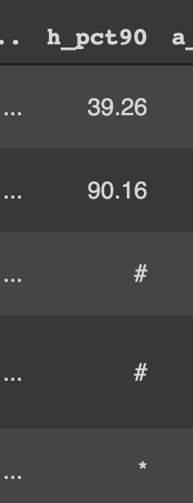
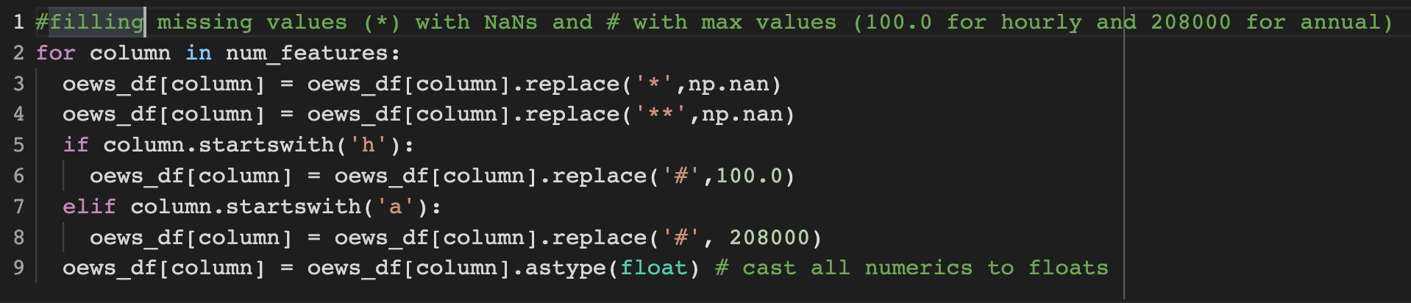
Data Cleaning Cont. (Ahmed/Alexander)
Missing values weren’t encoded as NaN or Null as is typical, instead that had symbols depending on type of missing information (#, *, **)
True missing values were filled with Numpy NaNs so they could be ignored in subsequent operation
*, ** values outside of the the range of the typical values were imputed using max()/min()
Notes:
Alexander/Ahmed
Merging two datasets hosting data from 2019 and 2020 (state_oews_2019_df, state_oews_2020_df)
Removing unnecessary features such as area_type, naics_title, own_code, hourly, year
Filtering numerical columns into list ['tot_emp','emp_prse','jobs_1000', 'loc_quotient', 'h_mean', 'a_mean', 'mean_prse', 'h_pct10', 'h_pct25', 'h_median', 'h_pct75', 'h_pct90', 'a_pct10', 'a_pct25', 'a_median', 'a_pct75', 'a_pct90']
Filling missing values (*) with NaNs and # with max values (100.0 for hourly and 208000 for annual)

Slide 6
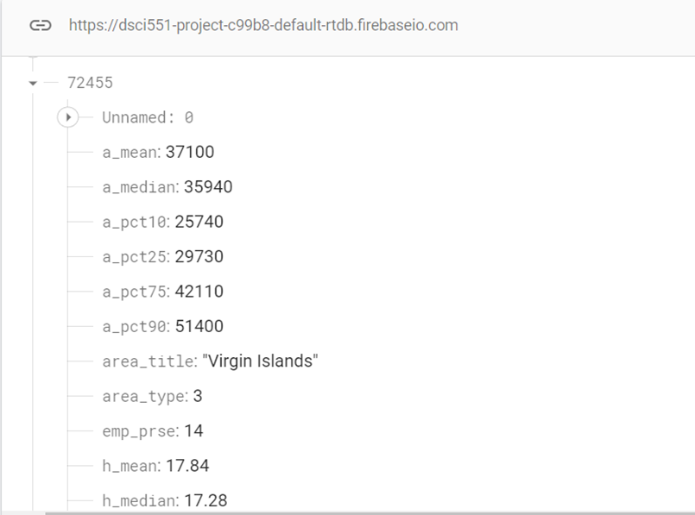
Data Storage (Ahmed)
Database management
Load cleaned data into database
NoSQL database Firebase
Update entities with additional attribute from another dataset
Build queries scripts for retrieving data
Data | 6
Notes:
Ahmed

Slide 7
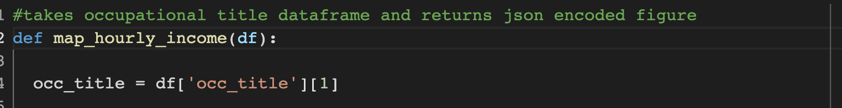
Data Visualization and Backend (Alexander)
The backend visualization scripts were again written and tested in Google Colab using the Plotly library before being embedded into the Flask scripts
The script first runs a Firebase query for a given occupation and then reads the JSON into a dataframe, which is passed into the visualization functions
A JSON encoding of a Plotly graph object is the visualized using a script.
Backend | 7
Notes:
Alexander

Slide 8
Application Framework
We are using Python Flask as our backend framework due to its advantage on:
Small code base and fast development phase.
Easy payload interaction between back and front using Jinja.
Simple routing.
Deployment
Using Amazon AWS EC2 instance to deployment of our app.
Using Gunicorn and Nginx to host the application
Tableau Public
Using its embedded code for creating the dashboard on Career Overview page.
Python Plotly
Using its javascript plugin for creating Career Details page.
Framework | 8
Notes:
Ruijie

Slide 9
Application Demonstration
http://13.57.225.54:5050/
Notes:
Ruijie
On the left hand side of the page, there is a large scatter graph that plots all the careers on their employment rate and annual salary.
On the right hand side of the page:
A table showing brief information on salary and employment of the highlighted career.
A rank on salary in red and a rank on employment rate in blue.
A rank on salary×employment in gold
Title shows the name of career title.
Career Description.
Overview Table of National Data: Employment Count, Employment Ratio and Education Required.
Map plot showing employment ratio in every states.
Bar plot showing change in national employment of this career across years.
Title shows the name of career title.
Career Description.
Overview Table of National Data: Mean Annual Income and Mean Hourly Income
Map plot showing mean annual income in every states.
Distribution plot showing income distribution.
Line plot showing change in annual income of this career across years.

